Slide 1
Signal Dispersion in Fibers

Slide 2
An optical signal weakens from attenuation mechanisms and broadens due to dispersion effects as it travels along a fiber.
Eventually these two factors will cause neighboring pulses to overlap.
After a certain amount of overlap occurs, the receiver can no longer distinguish the individual adjacent pulses and errors arise when interpreting the received signal

Slide 3
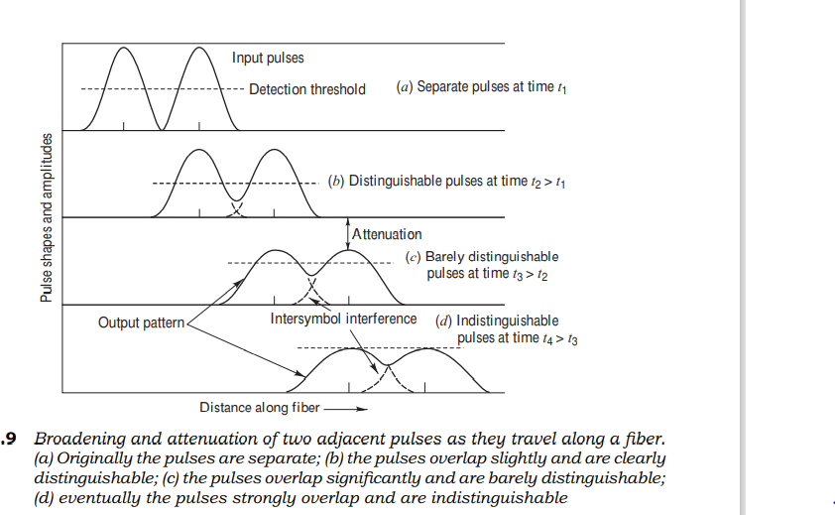

Slide 4
Overview of Dispersion Origins
Signal dispersion is a consequence of factors such as
intermodal delay (also called intermodal dispersion)
intramodal dispersion
polarization-mode dispersion
higher-order dispersion effects.
These distortions can be explained by examining the behavior of the group velocities of the guided modes, where the group velocity is the speed at which energy in a particular mode travels along the fiber

Slide 5
Intermodal delay
Intermodal delay (or simply modal delay) appears only in multimode fibers.
Modal delay is a result of each mode having a different value of the group velocity at a single frequency.

Slide 6
Intramodal dispersion
Intramodal dispersion or chromatic dispersion is pulse spreading that takes place within a single mode.
This spreading arises from the finite spectral emission width of an optical source.
The phenomenon also is known as group velocity dispersion, since the dispersion is a result of the group velocity being a function of the wavelength.
Because intramodal dispersion depends on the wavelength, its effect on signal distortion increases with the spectral width of the light source.
The spectral width is the band of wavelengths over which the source emits light.
This wavelength band normally is characterized by the root-meansquare (rms) spectral width.
Depending on the device structure of a light-emitting diode (LED), the spectral width is approximately 4 to 9 percent of a central wavelength.
For example, as Fig. illustrates, if the peak wavelength of an LED is 850 nm, a typical source spectral width would be 36 nm; that is, such an LED emits most of its light in the 832-to-868-nm wavelength band.
Laser diode optical sources exhibit much narrower spectral widths, with typical values being 1–2 nm for multimode lasers and 10-4 nm for single-mode lasers

Slide 32
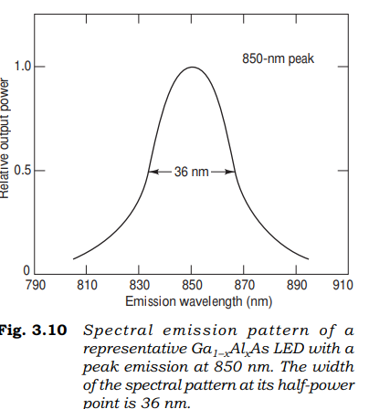

Slide 33
The two main causes of intramodal dispersion are as follows:
Material dispersion arises due to the variations of the refractive index of the core material as a function of wavelength.
Material dispersion also is referred to as chromatic dispersion, since this is the same effect by which a prism spreads out a spectrum.
This refractive index property causes a wavelength dependence of the group velocity of a given mode; that is, pulse spreading occurs even when different wavelengths follow the same path.

Slide 34
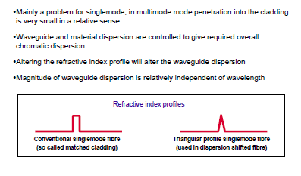

Slide 35
Waveguide dispersion causes pulse spreading because only part of the optical power propagation along a fiber is confined to the core.
Within a single propagating mode, the cross-sectional distribution of light in the optical fiber varies for different wavelengths.
Shorter wavelengths are more completely confined to the fiber core, whereas a larger portion of the optical power at longer wavelengths propagates in the cladding.
The refractive index is lower in the cladding than in the core, so the fraction of light power propagating in the cladding travels faster than the light confined to the core.
The index of refraction depends on the wavelength so that different spectral components within a single mode have different propagation speeds.

Slide 36
Dispersion thus arises because the difference in core-cladding spatial power distributions, together with the speed variations of the various wavelengths, causes a change in propagation velocity for each spectral component.
The degree of waveguide dispersion depends on the fiber design.
Waveguide dispersion usually can be ignored in multimode fibers, but its effect is significant in single-mode fibers.

Slide 37
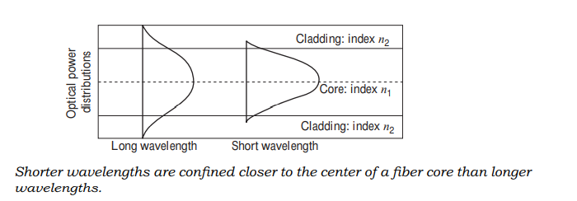

Slide 38
Polarization-mode dispersion
Polarization-mode dispersion results from the fact that light-signal energy at a given wavelength in a single-mode fiber actually occupies two orthogonal polarization states or modes.
At the start of the fiber the two polarization states are aligned.
However, since fiber material is not perfectly uniform throughout its length, each polarization mode will encounter a slightly different refractive index.
Consequently each mode will travel at a slightly different velocity.
The resulting difference in propagation times between the two orthogonal polarization modes will cause pulse spreading.

Slide 39

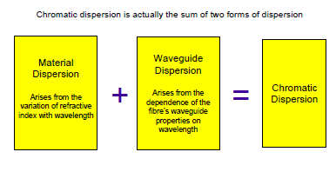

Slide 40


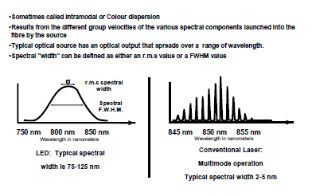

Slide 41

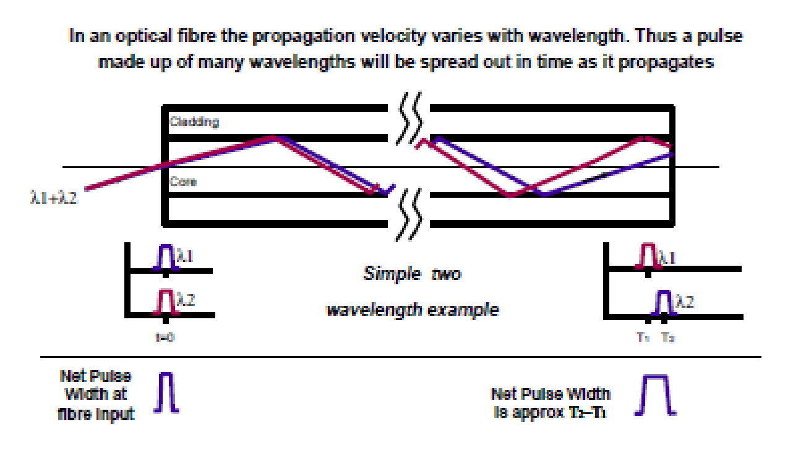

Slide 42
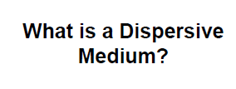

Slide 43

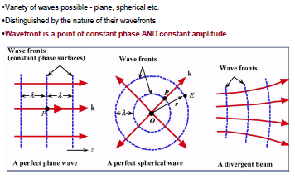

Slide 44
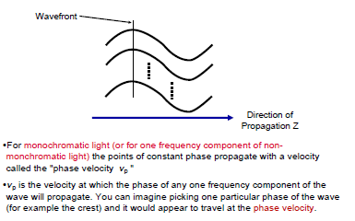

Slide 45

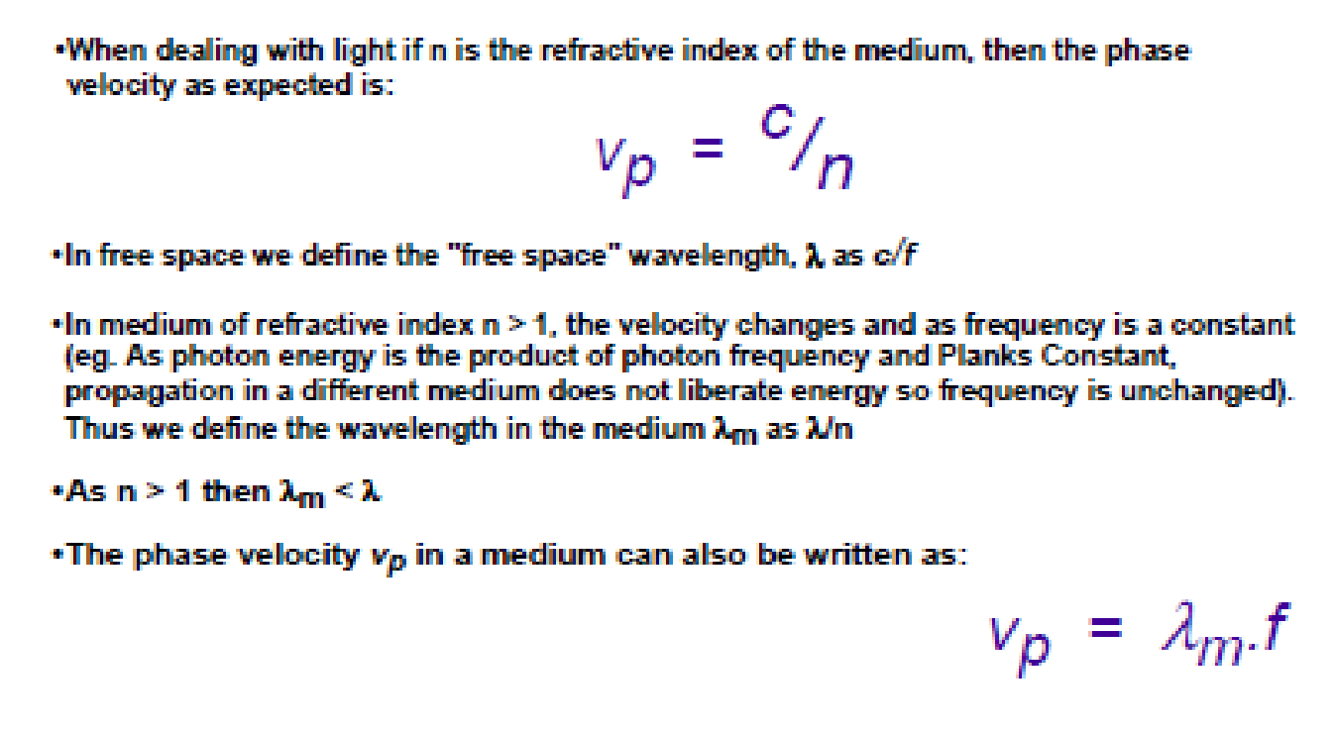

Slide 46
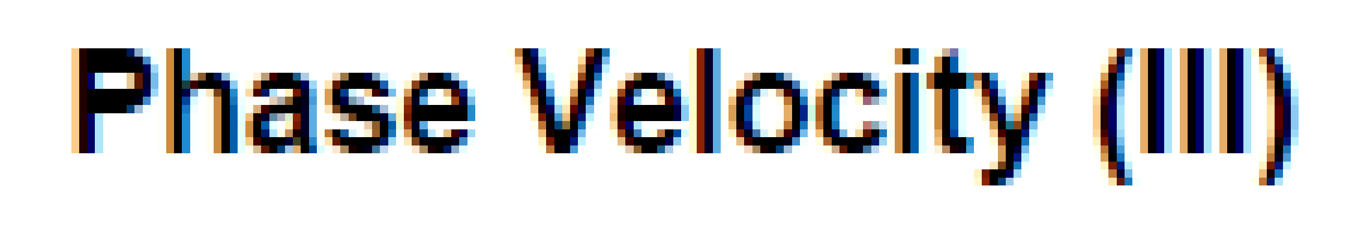
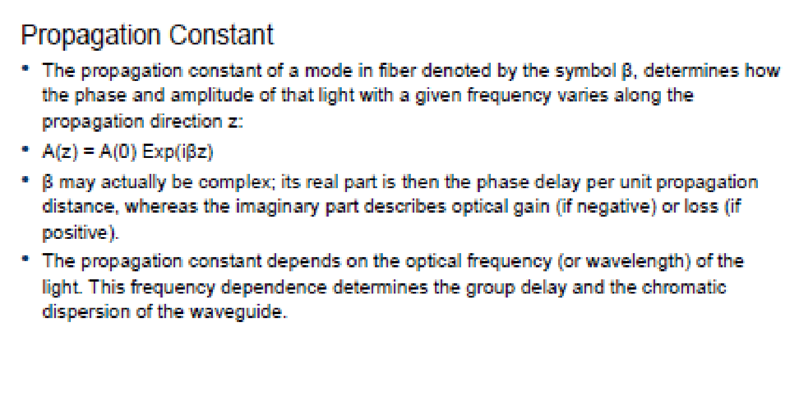

Slide 47
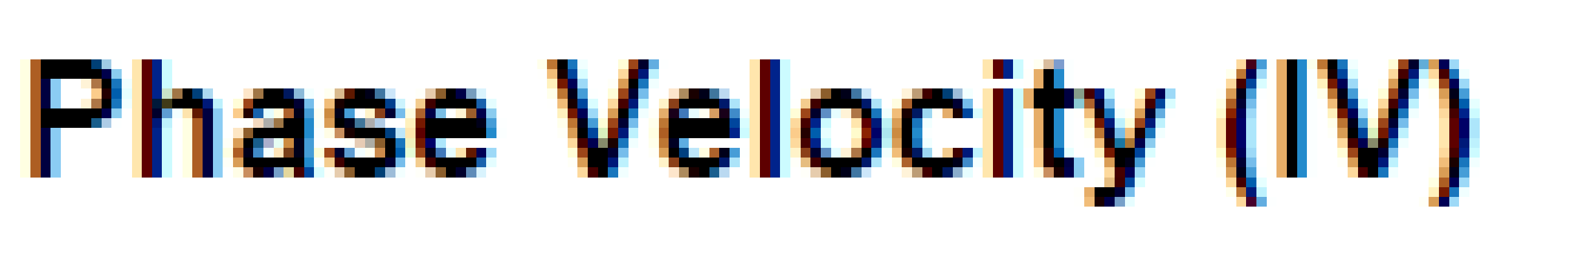
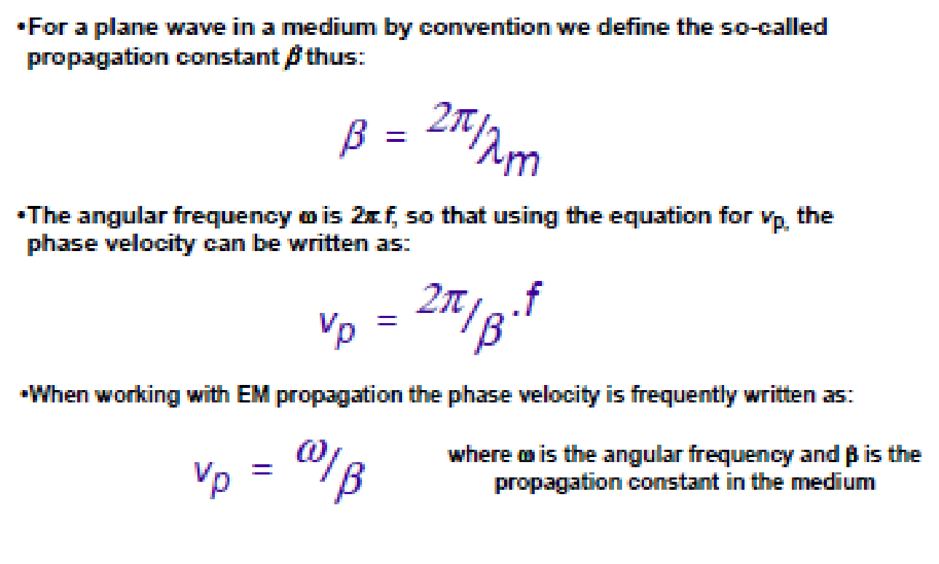

Slide 48

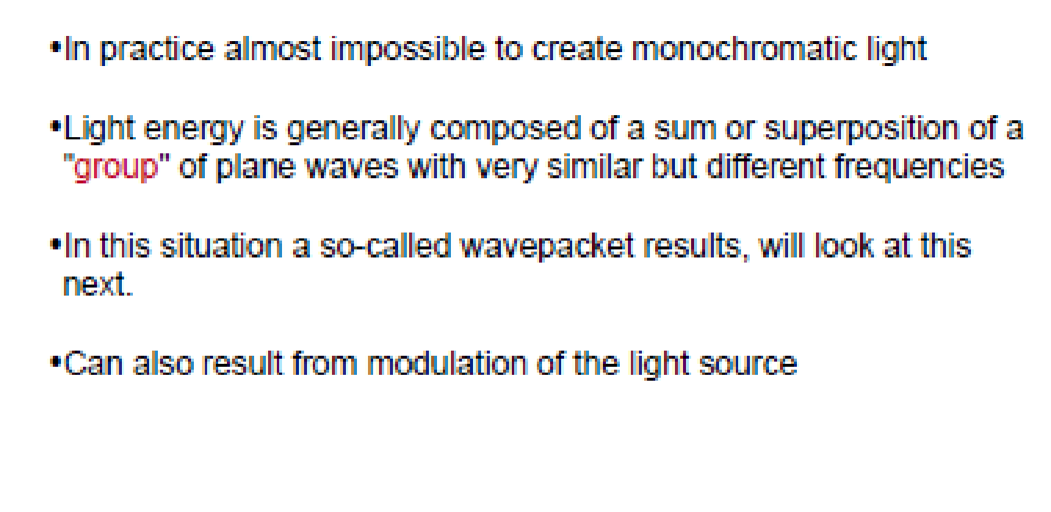

Slide 49

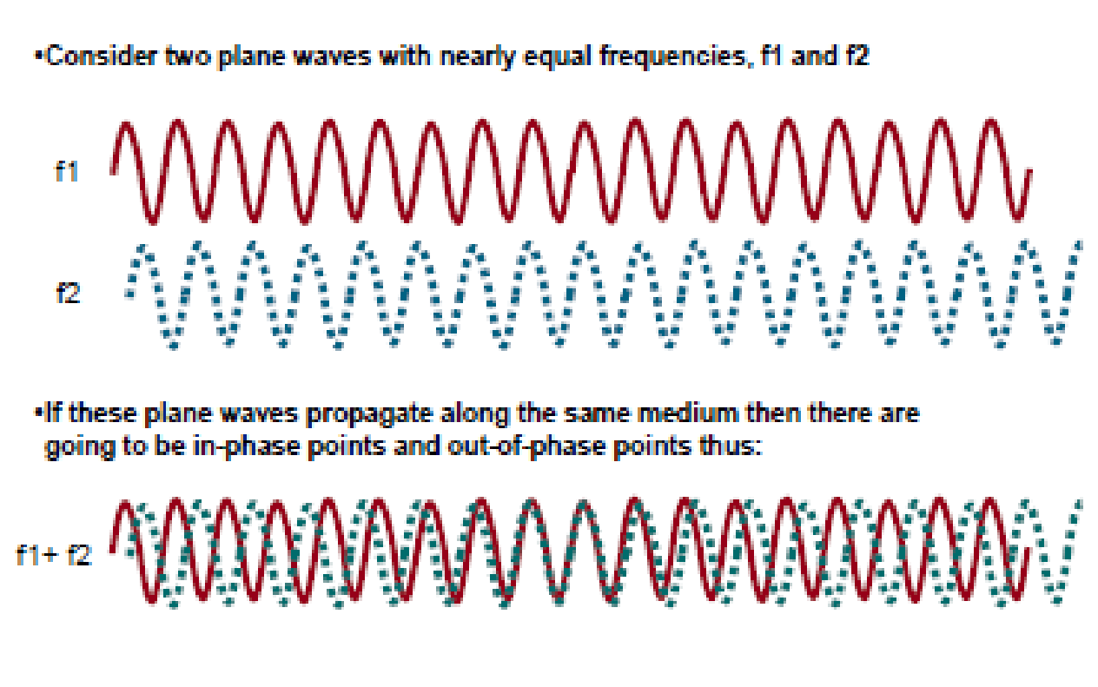

Slide 50

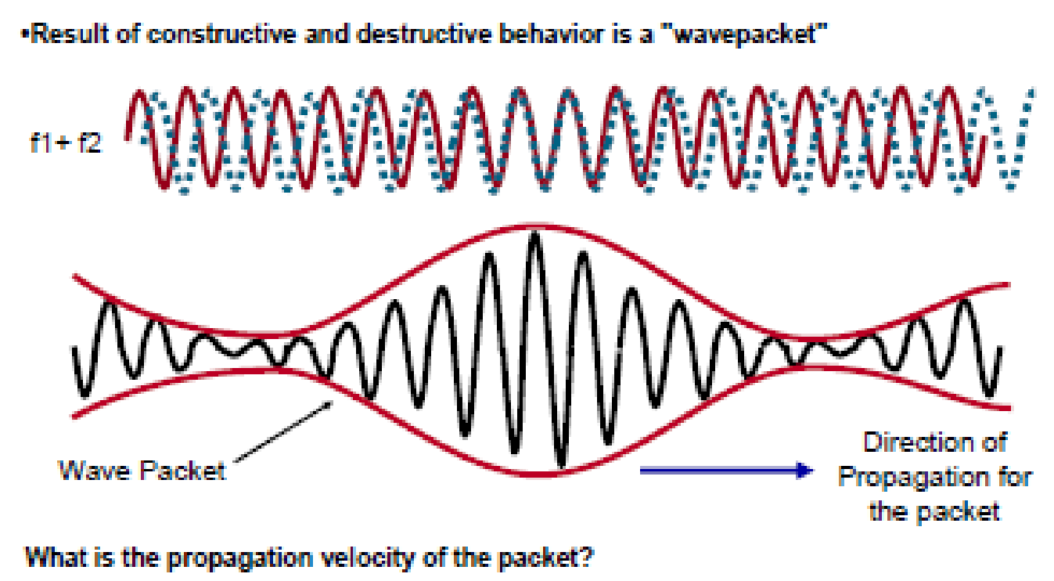

Slide 51
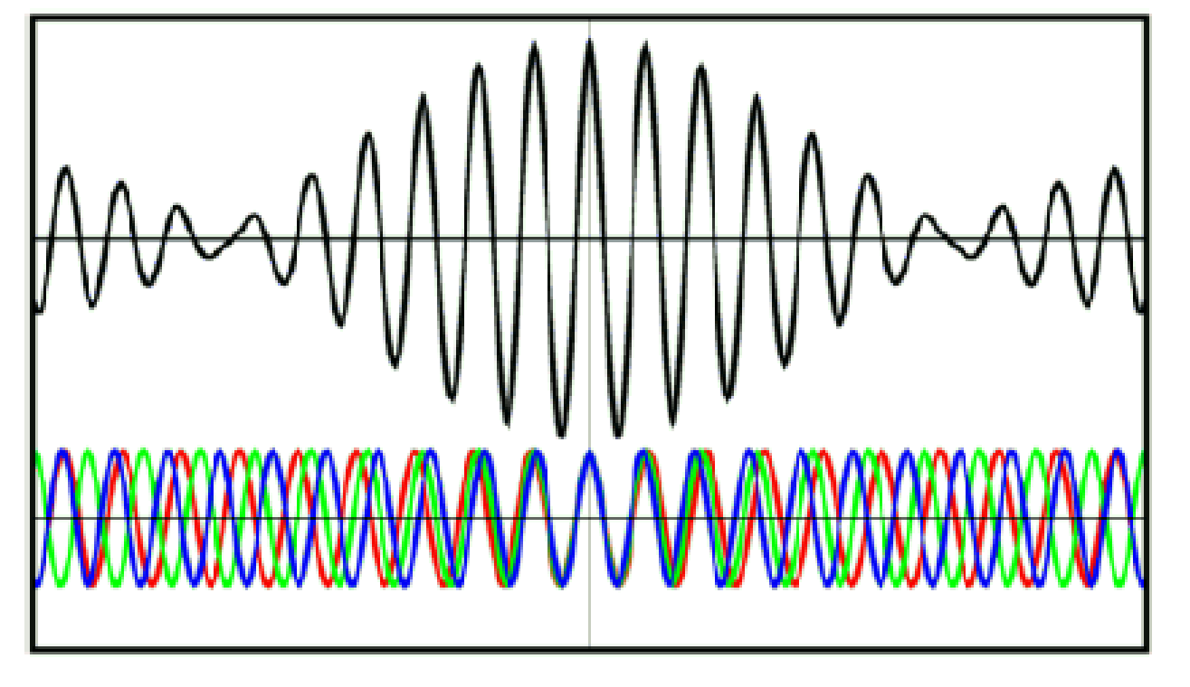

Slide 52

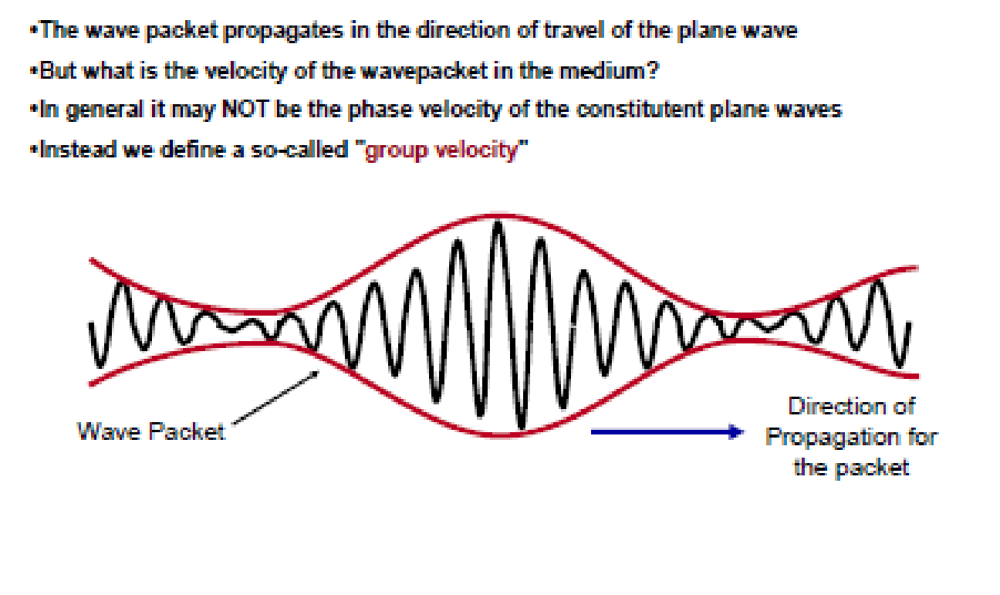

Slide 53

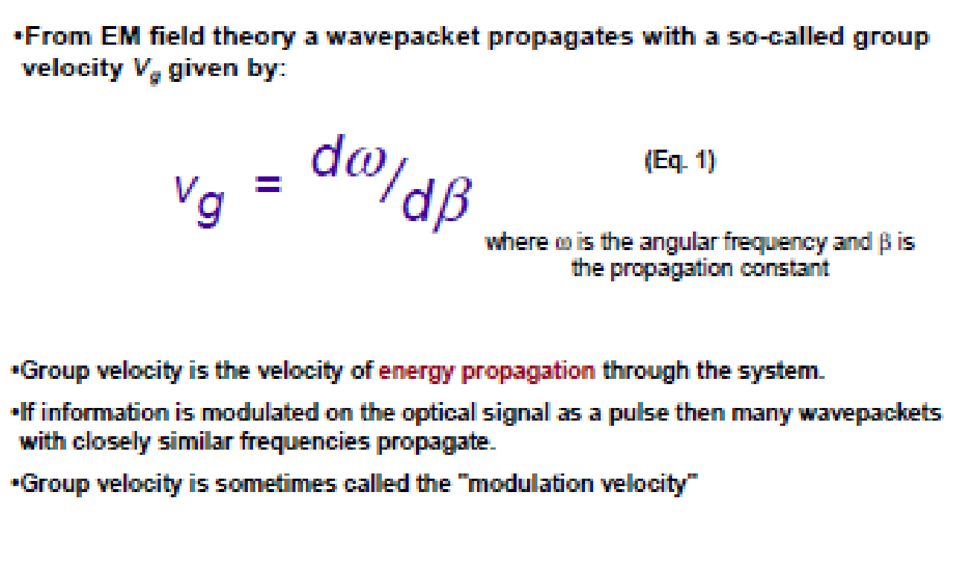

Slide 54

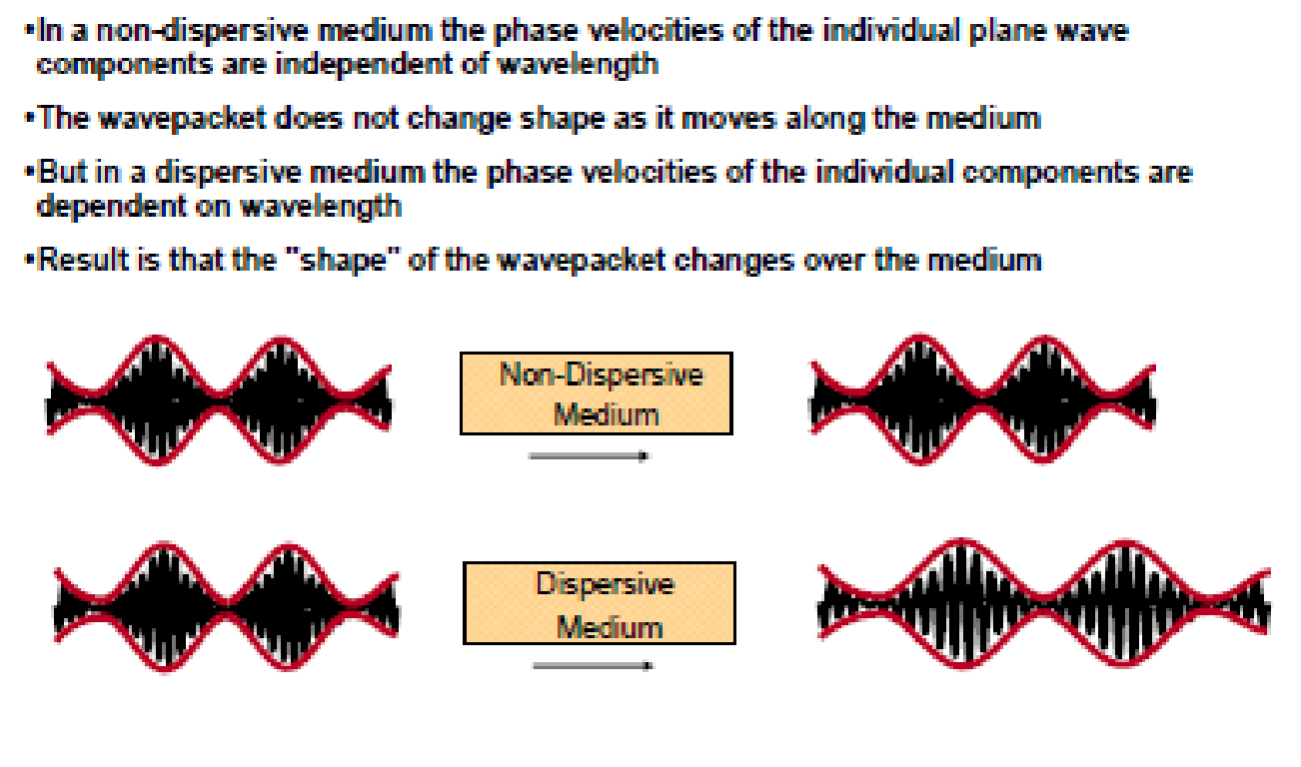

Slide 55
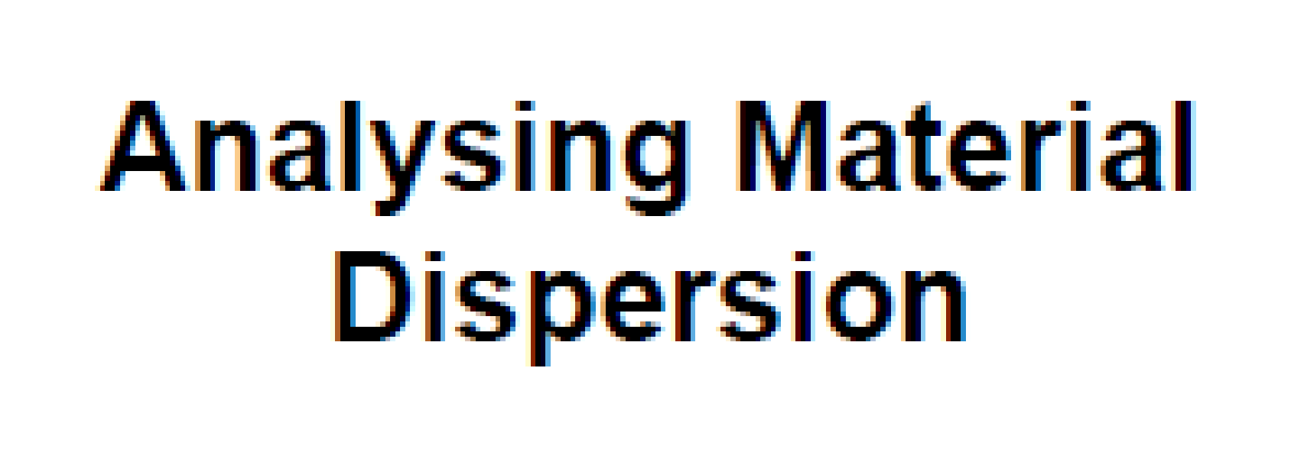

Slide 56

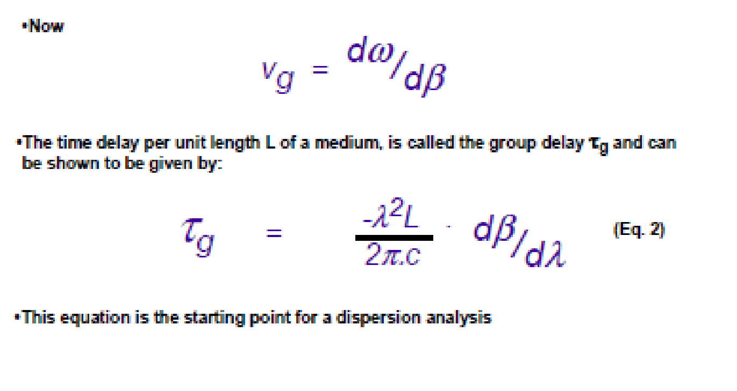

Slide 57

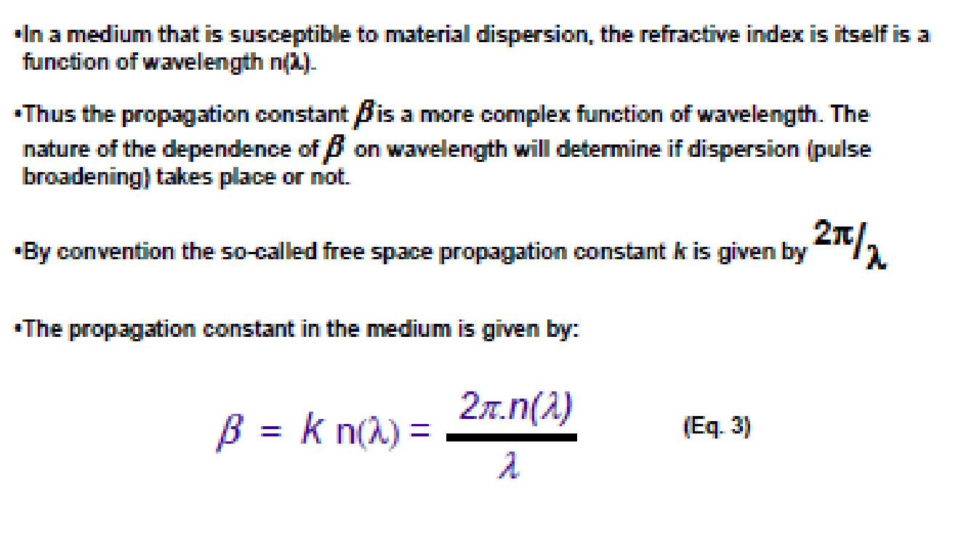

Slide 58

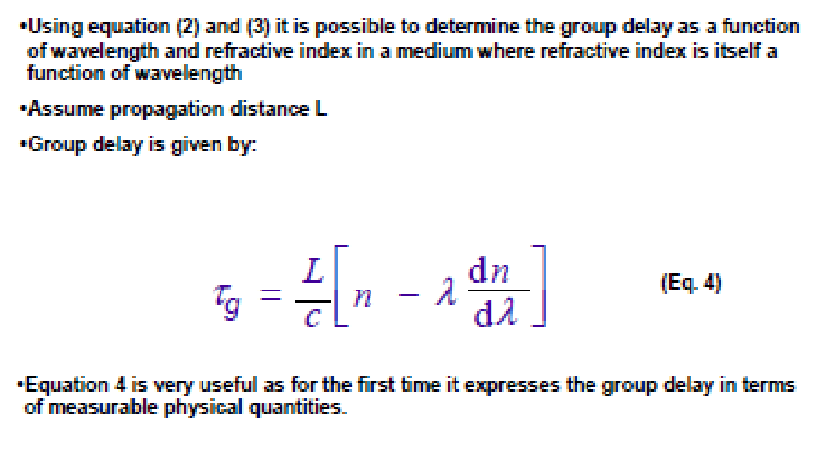

Slide 59
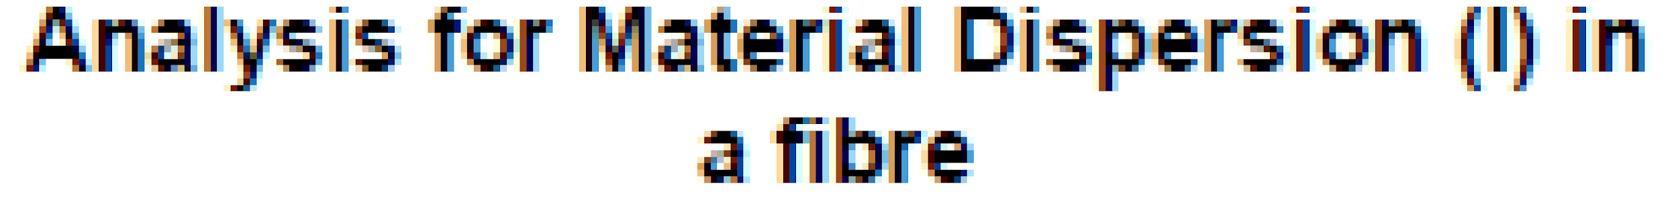
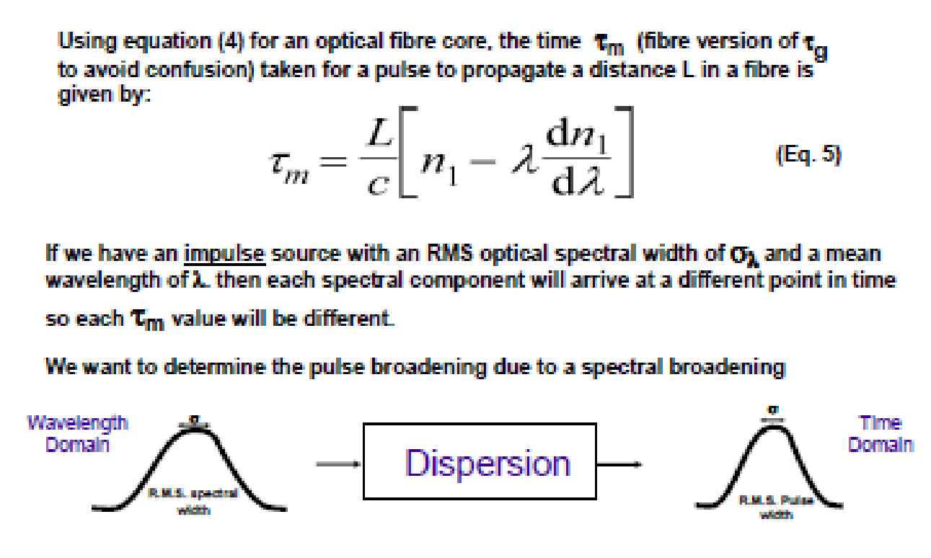

Slide 60
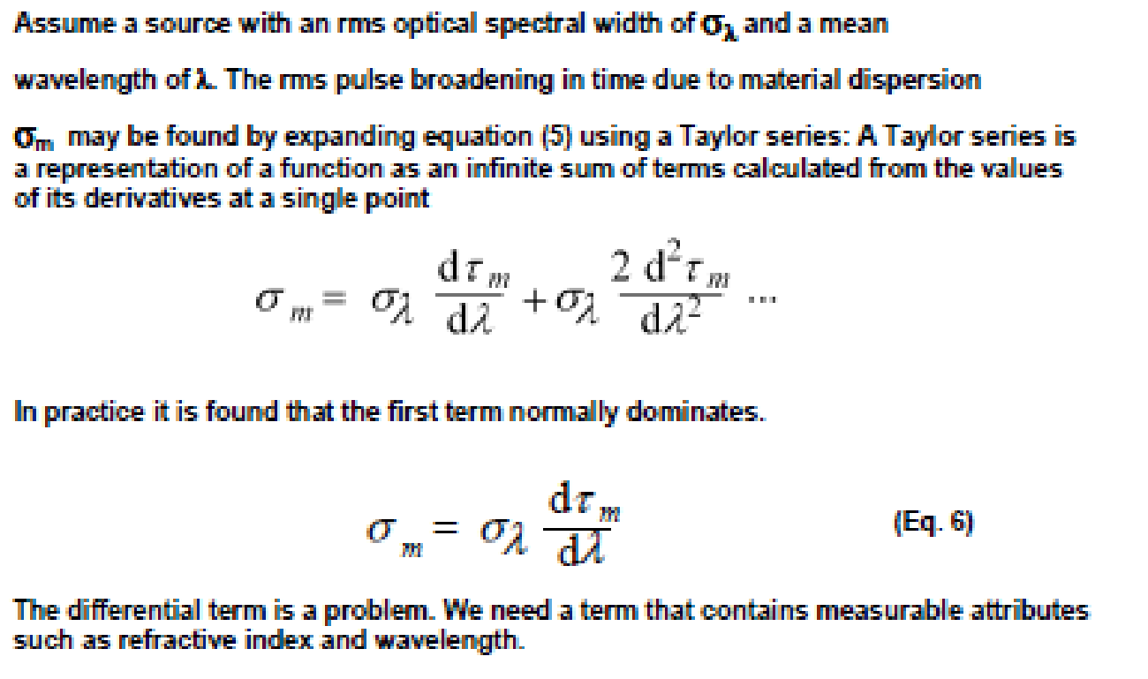

Slide 61

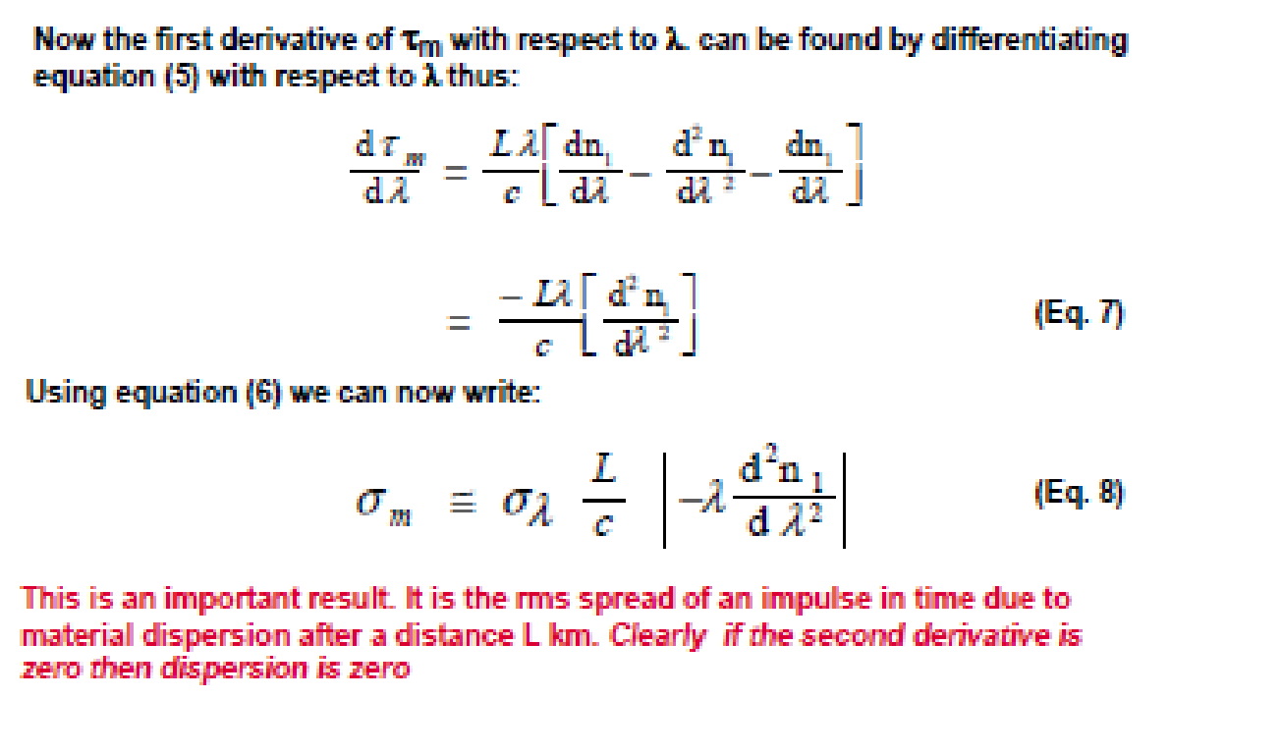

Slide 62
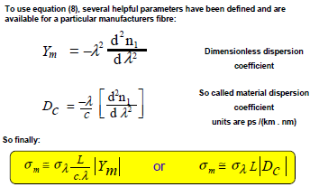

Slide 63
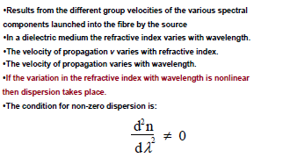

Slide 64
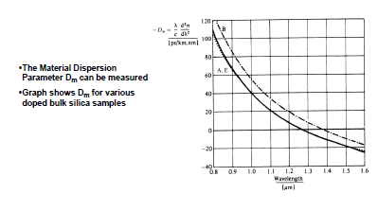

Slide 65

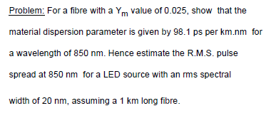

Slide 66

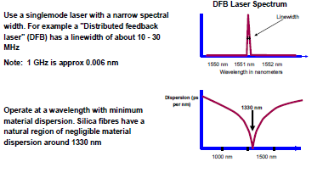

Slide 67
Modal Delay
Intermodal dispersion or modal delay appears only in multimode fibers.
This signal-distorting mechanism is a result of each mode having a different value of the group velocity at a single frequency.
The steeper the angle of propagation of the ray congruence, the higher is the mode number and, consequently, the slower the axial group velocity.
This variation in the group velocities of the different modes results in a group delay spread, which is the intermodal dispersion.

Slide 68



Intermodal Dispersion
Exists in multimode fiber cable
It causes the input light pulse to spread.
Light Pulse consists of group of modes. The light energy is delayed with different amount
along the fiber.

Slide 69
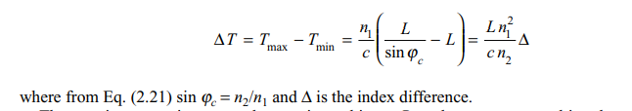
This dispersion mechanism is eliminated by single-mode operation but is important in multimode fibers.
The maximum pulse broadening arising from the modal delay is the difference between the travel time T_{max} of the longest ray congruence paths (the highest-order mode) and the travel time T_{min} of the shortest ray congruence paths (the fundamental mode).
This broadening is simply obtained from ray tracing and for a fiber of length L is given by

Slide 70
The fiber capacity is specified in terms of the bit rate-distance product BL, that is, the bit rate times the possible transmission distance L. In order for neighboring signal pulses to remain distinguishable at the receiver, the pulse spread should be less than 1/B, which is the width of a bit period.

Slide 71
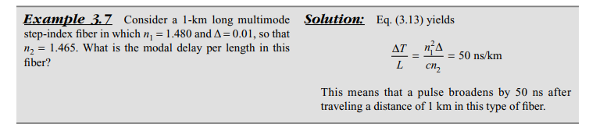

Slide 72
A successful technique for reducing modal delay in multimode fibers is through the use of a graded refractive index in the fiber core.
In any multimode fiber the ray paths associated with higher-order modes are concentrated near the edge of the core and thus follow a longer path through the fiber than lower-order modes (which are concentrated near the fiber axis).
However, if the core has a graded index, then the higher-order modes encounter a lower refractive index near the core edge.
Since the speed of light in a material depends on the refractive index value, the higher-order modes travel faster in the outer core region than those modes that propagate through a higher refractive index along the fi ber center.
Consequently this reduces the delay difference between the fastest and slowest modes.

Slide 73

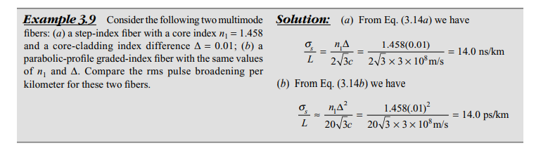
absolute modal delay at the output of a graded-index fiber that has a parabolic core index profile

Slide 74

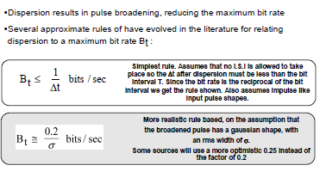

Slide 75
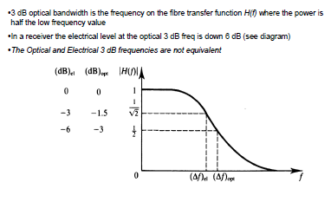

Slide 76
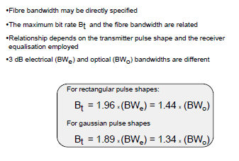

Slide 77
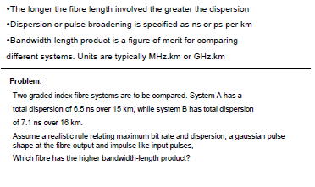

Slide 78
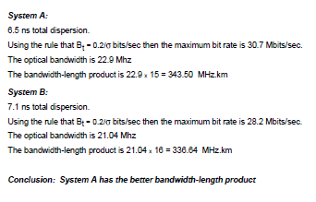

Slide 79

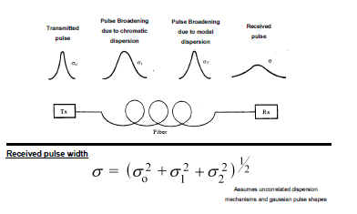

Slide 80

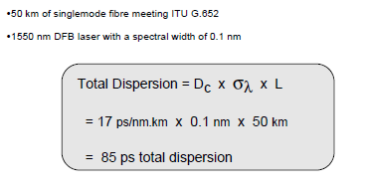

Slide 81
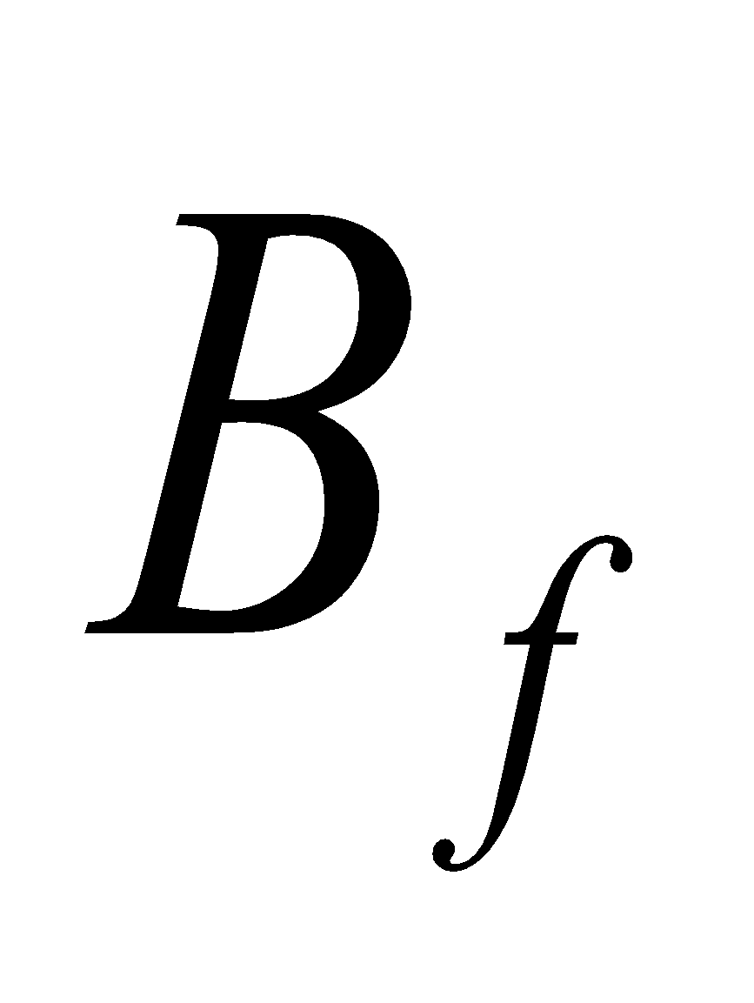
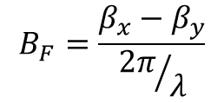
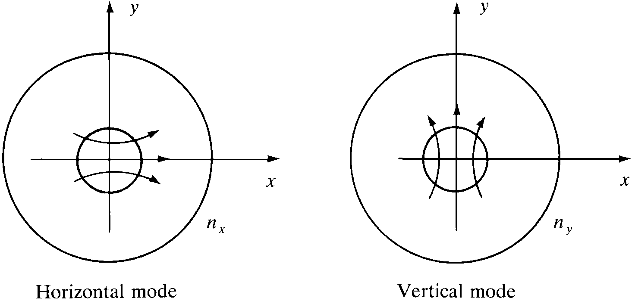
Birefringence in single-mode fibers
Because of asymmetries the refractive indices for the two degenerate modes (vertical & horizontal polarizations) are different. This difference is referred to as birefringence, :
Optical Fiber communications, 3rd ed.,G.Keiser,McGrawHill, 2000

Slide 82
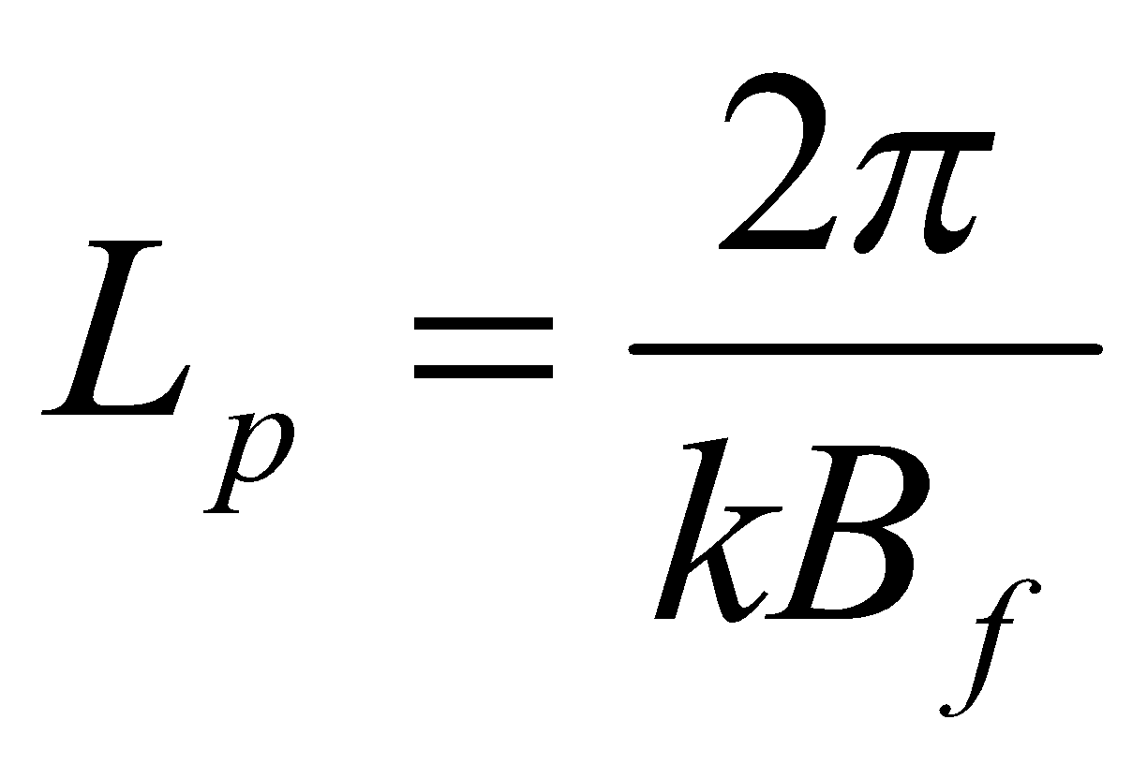
Fiber Beat Length
In general, a linearly polarized mode is a combination of both of the degenerate modes. As the modal wave travels along the fiber, the difference in the refractive indices would change the phase difference between these two components & thereby the state of the polarization of the mode. However after certain length referred to as fiber beat length, the modal wave will produce its original state of polarization. This length is simply given by:
[2-35]

Slide 83
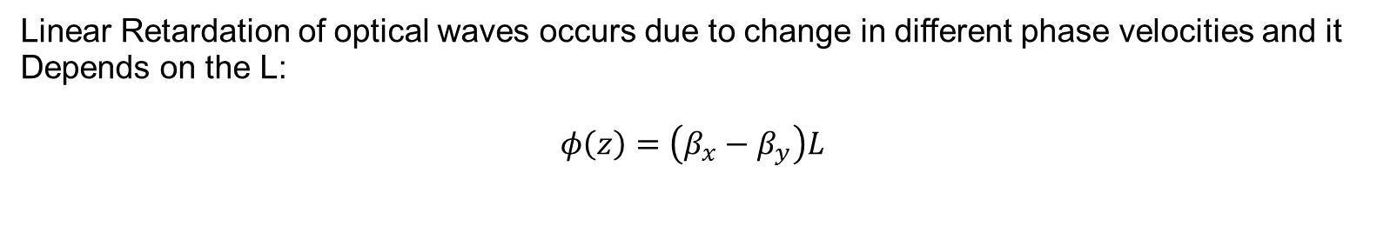


Modal Birefringence

Slide 84
Intermodal Dispersion
Exists in multimode fiber cable
It causes the input light pulse to spread.
Light Pulse consists of group of modes. The light energy is delayed with different amount
along the fiber.

Slide 85



Slide 86


Graded Index Fiber Structure
In graded index fiber, core refractive index decreases continuously with increasing radial distance r from center of fiber and constant in cladding
α defines the shape of the index profile
As α goes to infinity, above reduces to step index
The index difference is

Slide 87

contd
NA is more complex than step index fiber since it is function of position across the core
Geometrical optics considerations show that light incident on fiber core at position r will propagate only if it within NA(r)
Local numerical aperture is defined as
And

Slide 88

Examples
If a = 9.5 micron, find n2 in order to design a single mode fiber, if n1=1.465.
Solution,
The longer the wavelength, the larger refractive index difference is needed to maintain single mode condition, for a given fiber

Slide 89

Examples
Compute the number of modes for a fiber whose core diameter is 50 micron. Assume that n1=1.48 and n2=1.46. Wavelength = 0.8 micron.
Solution
For large V, the total number of modes supported can be estimated as

Slide 90

Example
What is the maximum core radius allowed for a glass fiber having n1=1.465 and n2=1.46 if the fiber is to support only one mode at wavelength of 1250nm.
Solution

